Slide 1
Chapter 16
Common security concepts

Slide 2
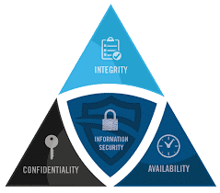
CIA
INTEGRITY
No authorized modifications
CONFIDENTIALITY
Protect data against unauthorized access
AVAILABILITY
Meet needs of legitimate users
Risks, Attacks, and Security Controls are often characterized by one or more of these goals
Notes:
Confidentiality: protecting your data from unauthorized access
Integrity: Doesn’t allow your data to modified without proper authorization
Availability: your data is accessible to authorized users when needed

Slide 3
Identify Threats
Adversarial Threats
deliberately undermine security
Example: Trusted insiders, Competitors, Suppliers, Customers, Business Partners, Nation-States
Consider their capability, intent, and likelihood
Accidental Threats
Occurs when someone makes a mistake that hurts the security of the system
Example: System administrator accidently takes servers offline causing loss of availability
Amazon Web Services (Feb 2017)
Technician utilized a SOP to take a small number of servers offline, but input the command incorrectly
Caused a large number of servers to go offline
It took down the entire US-EAST-1 region!
Notes:
Adversarial- Individuals, groups, or organizations deliberately trying to undermine your security

Slide 4
Identify Threats
Structural Threats
Occurs when equipment, software, or environmental controls fail
▪ Example:
IT server fails due to hard drive failure
Servers fail due to overheating (HVAC fail)
Software failure (OS bug or crash)
Environmental Threats
Occurs when natural or man-made disasters occur
Example:
Fires
Flooding
Severe storms
Loss of power from the city power grid
Fiber or telecommunication lines cut

Slide 5
Vulnerabilities
Common Vulnerabilities and Exposure
Common Vulnerabilities and Exposures (CVE)
Standard names for security-related software flaws
Common Vulnerability Scoring System (CVSS)
Standard approach for severity of software flaws
https://nvd.nist.gov/vuln-metrics/cvss
Zero Day
Exploits
Least Privilege
Role-Based access
Zero Trust
Notes:
CVE: each entry describes a vulnerability in detail, using a number and letter system to describe what it endangers, etc
CVSS: ranks vulnerabilities that are discovered based on predefined metrics
https://nvd.nist.gov/vuln-metrics/cvss
Zero Day: first day the virus has been released and no known fixes exists
Exploits: when a threat takes advantage of a vulnerability
Least privilege: giving users just enough permissions and access to do their jobs
Role-Based access control: creating a set of permissions for different job roles
Zero-trust: When you don’t know someone, you don’t give them access to your network

Slide 6
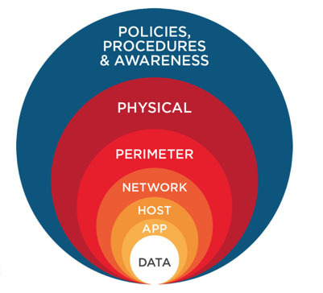
Defense in Depth
Network Segmentation enforcement
Screened Subnet
Separation of Duties
Network Access Control
Honeypot
Notes:
Defense in depth is having many layers of defense in order to keep your data safe
Network Segmentation: don’t keep everything in one place. Implement VLANS and port security on layer 2 switches
Screened Subnet: DMZ, created within two firewalls
Separation of duties: Having to complete two tasks to be completed by two different employees to prevent fraud or abuse
Network Access Control: examining the state of a computer’s OS updates and anti-malware updates before allowing access to the network
Honeypot: strategically configured to be attractive to hackers to lure them into spending enough time attacking them while information is gathered about the attack
A honeynet is an entire network configured to lure hackers

Slide 7
Authentication Methods
Multifactor
Terminal Access Controller Access Control System (TACACS+)
Single sign-on (SSO)
Remote Authentication Dial in User Service (RADIUS)
Kerberos
Local Authentication
802.1x

Slide 8
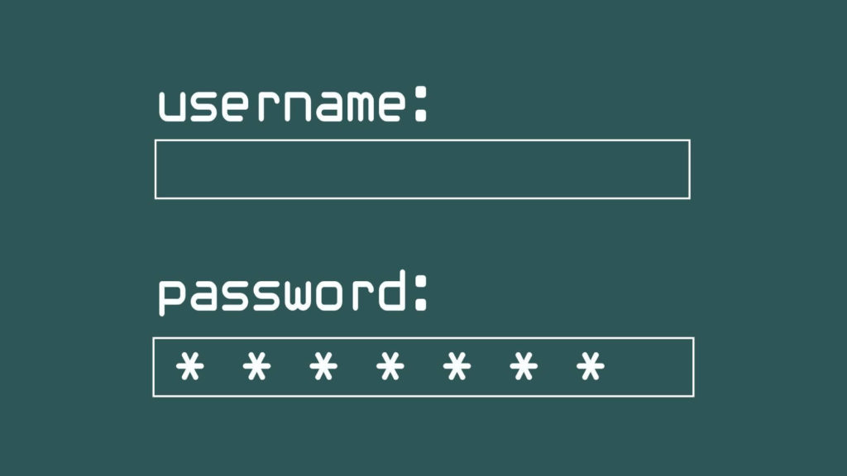


Factors of Authentication
Something you know
Such as username and password
Something you have
Such as a smart card
Something you are
Such as a fingerprint or other biometric identification
Somewhere you are
Such as your location obtained using geolocation
Something you do
Such as gestures on a touch screen

Slide 9
Authentication Methods
Authentication, Authorization, Accounting
Terminal Access Controller Access Control System (TACACS+)
Remote Authentication Dial in User Service (RADIUS)
LDAP
Lightweight directory access protocol
Ports 389 and 636
Single sign-on (SSO) w/ Kerberos
Kerberos
Microsoft
Port 88
Notes:
RADIUS: Combines authentication and authorization together, but runs accounting separately
Uses UDP
Shows the username in plain text and hashes the password
Used for network access
Open Source
TACACS+: Separates authentication, authorization, and accounting
Uses TCP
Encrypts the entire exchange from network device to the server
Used for device administration
CISCO proprietary
LDAP: Reads and writes data to a directory over an IP network
Organized set of records like a phone book/yellow pages, Windows Active Directory uses this protocol
SSO w/ Kerberos: authenticate one time, uses cryptographic keys in backend ticketing on the system
ONLY works with Kerberos!

Slide 10
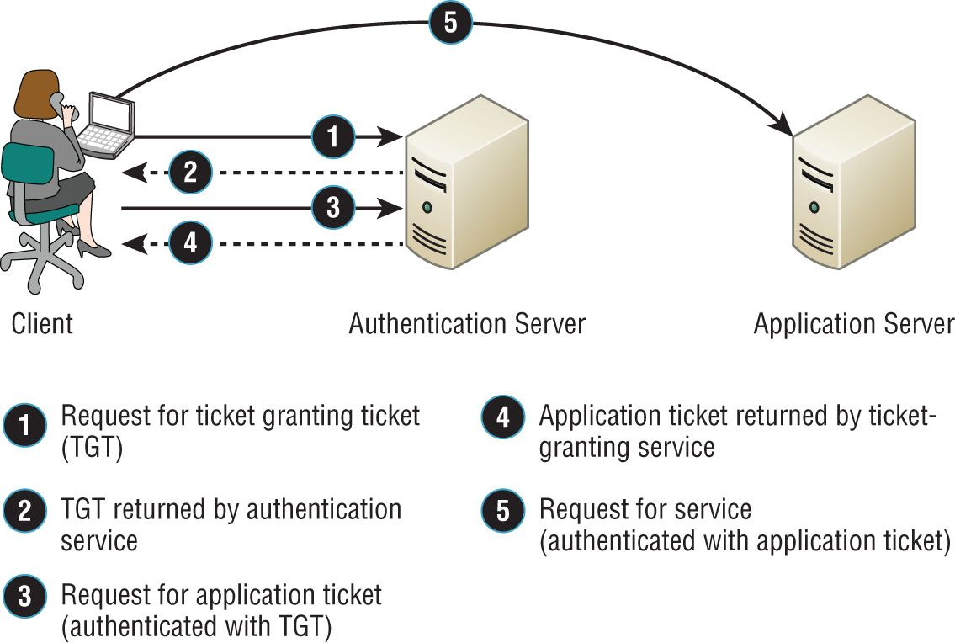
Kerberos
If your only Kerberos authentication server goes down, no one can log in to the network. So when running Kerberos, having redundant servers is vital.
10
Figure 16. 3: Kerberos authentication
Notes:
Network authentication protocol, you authenticate one time and the system trust you
Mutual authentication between client and server which prevents man-in-the-middle or (on-path attacks)

Slide 11
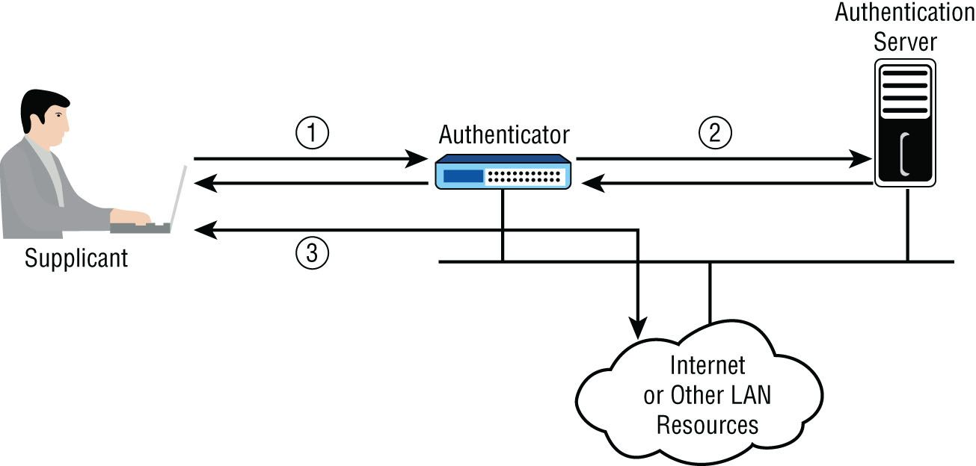
Authentication Methods
Local Authentication
Authentication is done on the host system only
Security Accounts manager (SAM)
802.1x
Framework for port-based authentication
Uses EAP (Extensible Authentication Protocol)- authenticates the device
Notes:
Local authentication: Users local account and password are verified with the local user database
Every change to an account is done on the host device and does not carry over to other devices
802.1X: when you plug in a device, based on the way you configure that port determines what type of access to grant a user based on the device they have
EAP is the mechanism that attempts to authenticate that specific device
3 components
Supplicant: the user of device requesting access to the network
Authenticator: the device through which the supplicant is attempting to access the network
Authentication server: the centralized device that performs authentication

Slide 12
Threat Intelligence
What is threat intelligence?
Data and information about adversaries (motivations, capabilities, tools, and methodologies)
Why do we need threat intelligence?
Help security professionals fully understand threats to prevent them or to limit their impact
Notes:
Research our threats, check on hacker blogs, utilize similar hacker tools to understand how they work and their capabilities
Based off the intelligence you gather, you can apply better prevention measures

Slide 13
Vulnerability Assessment
Identification, prioritization, and remediation of vulnerabilities before a threat can exploit them
An organized approach to scanning and continuous assessment of your organizational security posture
Non- Intrusive
Notes:
Identifying vulnerabilities using a vulnerability scanner
Test threats from the outside and the inside

Slide 14
Penetration Testing
Very Intrusive
Blind Test
Pentester knows very little about the organization
Security team knows the test is coming
Double-Blind Test
Same as blind test but security team does not know the test is coming
Target Test
Maximum information is given to both the testers and the security teams
Notes:
Simulate an attack, usually contracted through a third-party

Slide 15
Risk Assessments
Quantitative
Qualitative
Process Assessment
Vendor Assessment
SIEM
Notes:
Identify assets that may get attacked
Figure out those risk and what would be the effects
Identify the threats
Determine risk level
Create a process to improve the risk levels
Process Assessment: is assessing how up to date our processes, policies, and procedures as technology is ever-evolving
Vendor Assessment: perform a risk assessment before sharing data with a vendor; put security policies in the contract
Security Information and Event Management: large database for logging security events and information
Centralized log information with security alerts, collect data from diverse devices and long-term storage of information

